Slide 1
Lecture Pushdown Automata

Slide 2
tape
tape head
stack head
finite
control
stack

Slide 3
a
l
p
h
a
b
e
t
The tape is divided into finitely many cells. Each cell contains a symbol in an alphabet Σ.

Slide 4
The stack head always scans the top
symbol of the stack. It performs two
basic operations:
Push: add a new symbol at the top.
Pop: read and remove the top symbol.
Alphabet of stack symbols: Γ

Slide 5
a
The head scans at a cell on the tape and can read a symbol on the cell. In each move, the head can move to the right cell.

Slide 6
The finite control has finitely many states which form a set Q. For each move, the state is changed according to the evaluation of a transition function
δ : Q x (Σ U {ε}) x (Γ U {ε}) → 2 .
Q x (Γ U {ε})

Slide 7

a
a
q
p
u
v
(p, u) δ(q, a, v) means that if the tape head reads a, the stack head read v, and the finite control is in the state q, then one of possible moves is that the next state is p, v is replaced by u at stack, and the tape head moves one cell to the right.

Slide 8
a
a
q
p
u
v
(p, u) δ(q, ε, v) means that this a ε-move.

Slide 9
a
a
q
p
u
(p, u) δ(q, a, ε) means that a push operation
performs at stack.

Slide 10
a
a
q
p
v
(p, ε) δ(q, a, v) means that a pop operation performs at stack

Slide 11
s
There are some special states: an initial state s and a final set F of final states.
Initially, the PDA is in the initial state s and the head scans the leftmost cell. The tape holds an input string. The stack is empty.

Slide 12
x
f
When the head gets off the tape, the PDA stops. An input string x is accepted by the PDA if the PDA stops at a final state and the stack is empty.
Otherwise, the input string is rejected.

Slide 13
The PDA can be represented by
M = (Q, Σ, Γ, δ, s, F)
where Σ is the alphabet of input symbols and Γ is the alphabet of stack symbols.
The set of all strings accepted by a PDA M is denoted by L(M). We also say that the language L(M) is accepted by M.

Slide 14

The transition diagram of a PDA is an alternative way to represent the PDA.
For M = (Q, Σ, Γ, δ, s, F), the transition diagram of M is an edge-labeled digraph G=(V, E) satisfying the following:
V = Q (s = , f = for f F)
E = { q p | (p,u) δ(q, a, v) }.
a, v/u

Slide 15
Example 1. Construct PDA to accept
L= {0 1 | n > 0}
n
n
Solution 1.
1, 0/ε
0, ε/0
1, 0/ε

Slide 16
Solution 2.
Consider a CFG
G = ({S}, {0,1}, {S → ε | 0S1}, S).
ε, ε /1
ε, ε/S
ε, ε/S
ε, ε/0
ε, S/ε
0, 0/ε
1, 1/ε

Slide 17
Theorem Every CFL can be accepted by a PDA.
Proof.
Consider a CFL L = L(G) for a CFG
G = (V, Σ, R, S).
ε, A/xn
A → x1 x2 …xn in R
ε, ε/S
ε, ε/x1
a, a/ε for a in Σ
Theorem

Slide 18
Sometimes, constructing the PDA is easier than
constructing CFG.

Slide 19
Example 2
Construct a PDA or a CFG?
PDA!!!
Sometimes, constructing the PDA is easier than
constructing CFG.

Slide 20
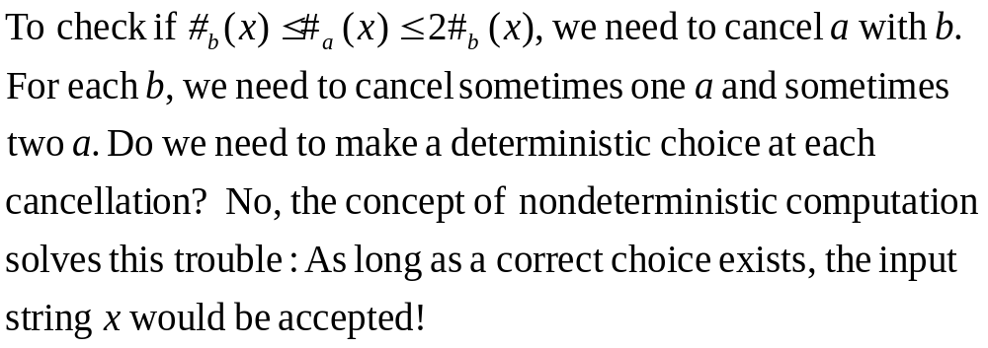
Idea

Slide 21

a
a
s
p
s
(p, s) δ(s, ε, ε)

Slide 22



a
a
p
p
a
s
s
(q, s) δ(p, a, s)
(p, a) δ(q, ε, ε)

Slide 23

a
a
p
p
a
a
a
(q1, a) δ(p, a, a)
(p, a) δ(q1, ε, ε)

Slide 24

a
a
p
p
b
(p, ε) δ(p, a, b)

Slide 25

a
a
p
p
b
b’
(p, b’) δ(p, a, b)

Slide 26

a
a
p
p
b’
(p, ε) δ(p, a, b’)

Slide 27


b
b
p
p
b
s
s
(r1, s) δ(p, b, s)
(p, b) δ(r1, ε, ε)

Slide 28

b
b
p
p
b
b
b
(r2, b) δ(p, b, b)
(p, b) δ(r2, ε, ε)

Slide 29

b
b
p
p
b
b’
b’
(r3, b’) δ(p, b, b’)
(p, b) δ(r3, ε, ε)

Slide 30

b
b
p
p
a
(p, ε) δ(p, b, a)

Slide 31

b
b
p
p
a
a
(t, ε) δ(p, b, a)
(p, ε) δ(t, ε, a)

Slide 32
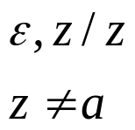

b
b
p
p
a
b’
z
z≠a
z
(t, ε) δ(p, b, a)
(u, x) δ(t, ε, x)
(p, b’) δ(u, ε, ε)

Slide 33

p
p
s
(p, ε) δ(p, ε, s)

Slide 34







Slide 35
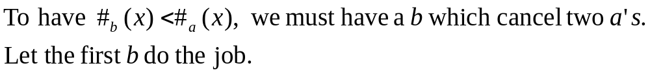
Example 3
Idea

Slide 36
Solution
1
1
1
1

Slide 37
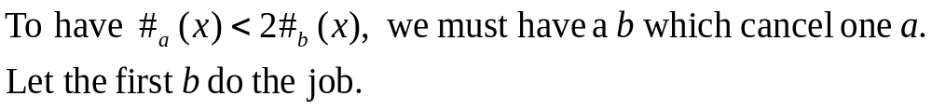
Example 4
Idea

Slide 38
Solution
1
1
1
1

